Slide 1
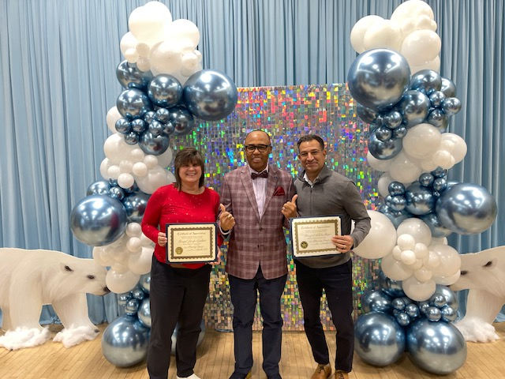


Literacy Proficiency
Math Proficiency
Chronic Absenteeism & Retention
Parent Engagement
Community
Superintendent
Dr. Eric L. Blake
Deputy Superintendent
Dr. Shonelle Hall
January 2, 2025
“With effort and support all schools can meet the needs of their students and help them achieve outstanding educational outcomes”

Slide 3

Happy New Year!
Welcome back, students, families, and the entire school community! We hope you had a wonderful holiday break and are ready to embark on an exciting new year new journey. Wishing you all the very best for 2025 and beyond, filled with joy, growth, and success. Let's make this an amazing time working together!

Slide 4
District 28 Vision, Mission & Goals
The United Nations' mission statement includes the line, "In this noble undertaking, cooperation, collaboration, unity, and solidarity must be the light we should seek and follow. We commit to strive for inestimable contribution to human progress."
Mission
In Community School District 28 we focus on equity as a lever for achievement for every single scholar. We are a district of excellence. We commit to every school maintaining high academic standards and working closely with families so that all scholars are learning at high levels. Beginning with school leaders, teachers, students and community partners, we also commit to being a district of learners ensuring that we promote critical thinking rooted in core content conceptual understanding through creative problem solving, technology innovation, social emotional learning and community advocacy.
Vision
In Community School District 28 we celebrate our differences because we understand that woven into those differences is the knowledge that they offer us unlimited possibility to learn and expand our knowledge of and commitment to all humanity. We are beautifully diverse, varied; coming from countless racial, ethnic, language, and belief backgrounds. We commit to striving for inestimable contribution to the lives of our scholars.

Slide 5
NYCPS Chancellor Avilles – Update
Chancellor Aviles [RE: Updates to NYC Reads Implementation]
Implementing a new curriculum is challenging, and we appreciate our school leaders and teachers' efforts. Based on feedback, we are updating policies on pacing flexibility, assessments, and professional learning, categorized into five key areas.
Acknowledgment of Efforts: Recognizing the significant efforts of school leaders and teachers in implementing the new curriculum.
Policy Updates: Updating policies based on feedback to address pacing flexibility, assessment processes, and professional learning.
Pacing Flexibility: Allowing up to two weeks of flexibility in pacing to meet students' unique needs while maintaining curriculum alignment.
Assessment Streamlining: Streamlining assessments to focus on essential standards, particularly emphasizing end-of-module/unit assessments.
Instructional Prioritization: Giving teachers time to prioritize classroom instruction and small group activities, ensuring high-quality, standards-aligned teaching.

Slide 6
NYCPS Chancellor Avilles – Update
Expanding professional learning for all involved in NYC Reads
Targeted Strategies: Professional learning will focus on practical strategies using existing curriculum tools.
Support for All: Training will support superintendents, district teams, school leaders, and teachers to meet diverse student needs.
Resource Identification: Emphasis on identifying and using embedded curriculum resources.
Feedback-Driven: Opportunities will address feedback, especially for English Language Learners and Students with Disabilities.
Shared Goal: Aim to ensure all students graduate as proficient readers and learners, providing clarity to districts and educators.

Slide 7
Reading Strategies @ HOME:
THE POWER OF READING: Reading offers a variety of benefits including reducing stress, improving memory, increasing empathy, enhancing vocabulary, boosting focus and concentration, improving sleep quality, expanding knowledge, and potentially contributing to a longer life by preventing cognitive decline as you age.
STRATEGIES:
Model reading behavior:
Show your child that you enjoy reading by reading yourself in front of them.
Read aloud regularly:
Make reading a daily routine, even if the child can read independently, as it helps with comprehension and exposure to different writing styles.
Ask Questions about the TEXT - Encourage critical thinking by asking open-ended questions about the story, characters, and plot.
Discuss vocabulary - Explain new words encountered while reading and incorporate them into conversation.
Practice shared reading - Take turns reading sections of a book together, pointing to words as you read.
Encourage independent reading - Give your child time to read independently, allowing them to choose books that interest them.
Choose engaging books:
Select books that match your child's interests and reading level to make the experience more enjoyable.
Play word games - Engage in activities like word puzzles, rhyming games, and other word-based games to strengthen vocabulary and phonics skills.
Create a reading environment -Designate a quiet, comfortable space with easy access to books for reading time.
Be patient and supportive:
Celebrate small achievements and provide positive feedback to keep your child motivated.
Collaborate with the teacher - Stay informed about your child's reading progress at school and discuss strategies to support their learning at home
Resource: Parent strategies for improving their child’s reading and writing

Slide 8
Simplifying data collection using tools within the curriculum that already exist
Teachers should focus on instruction, not extra data entry. Districts will use digital tools to eliminate redundant tasks and outdated practices, ensuring data is accessible within current curricula and digital platforms.
Educators can modify the curriculum to meet student needs, using NYC Reads and TeachHub resources, while focusing on one grade level in multigrade classes and adapting for others.
Time and flexibility for educators to make adjustments as needed

Slide 9
D28 Attendance Snapshot​
DCEP - Attendance Goals​
By June 2025, we will increase district-wide attendance by 2 percentage points from 90.7% to 92.7% excluding students who are long-term international travelers.​
By June 2025, we will reduce overall chronic absenteeism by 10% of overall Chronically Absent Students EOY 23/24 from 35% to 31%, excluding students who are long-term international travelers.​
​
Where are we Now: 12/20/24​
YTD Overall Attendance: 92.1% vs 90.7% Citywide​
Vs 91.5 2023 , showing increase overall.
Chronic Absenteeism YTD: 28.2% vs 29.6% SAME DATE LAST YEAR, representing an overall decrease
​
​

Slide 10
Congratulations! ​
Congratulations to Principals Jennifer Lucadamo from PS 144 and Nicholas Sforza from PS 99 on achieving Principal tenure!
This milestone reflects their dedication, leadership, and unwavering commitment to excellence in education. Achieving tenure requires exceptional qualities such as vision, resilience, and the ability to inspire both staff and students. Your hard work and passion have made a significant impact on your school communities, and we celebrate your well-deserved success!

Slide 11

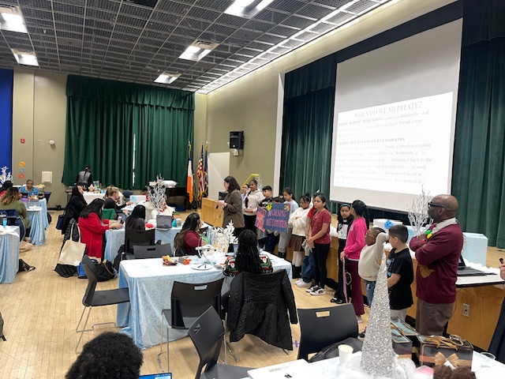
D28 SEL Focus Highlight
PS 55Q The Maure Magnet School ​
Special thanks to Principal Honore and the wonderful students of PS 55 for their incredible facilitation at our Principal’s Conference around their SEL practices

Slide 12


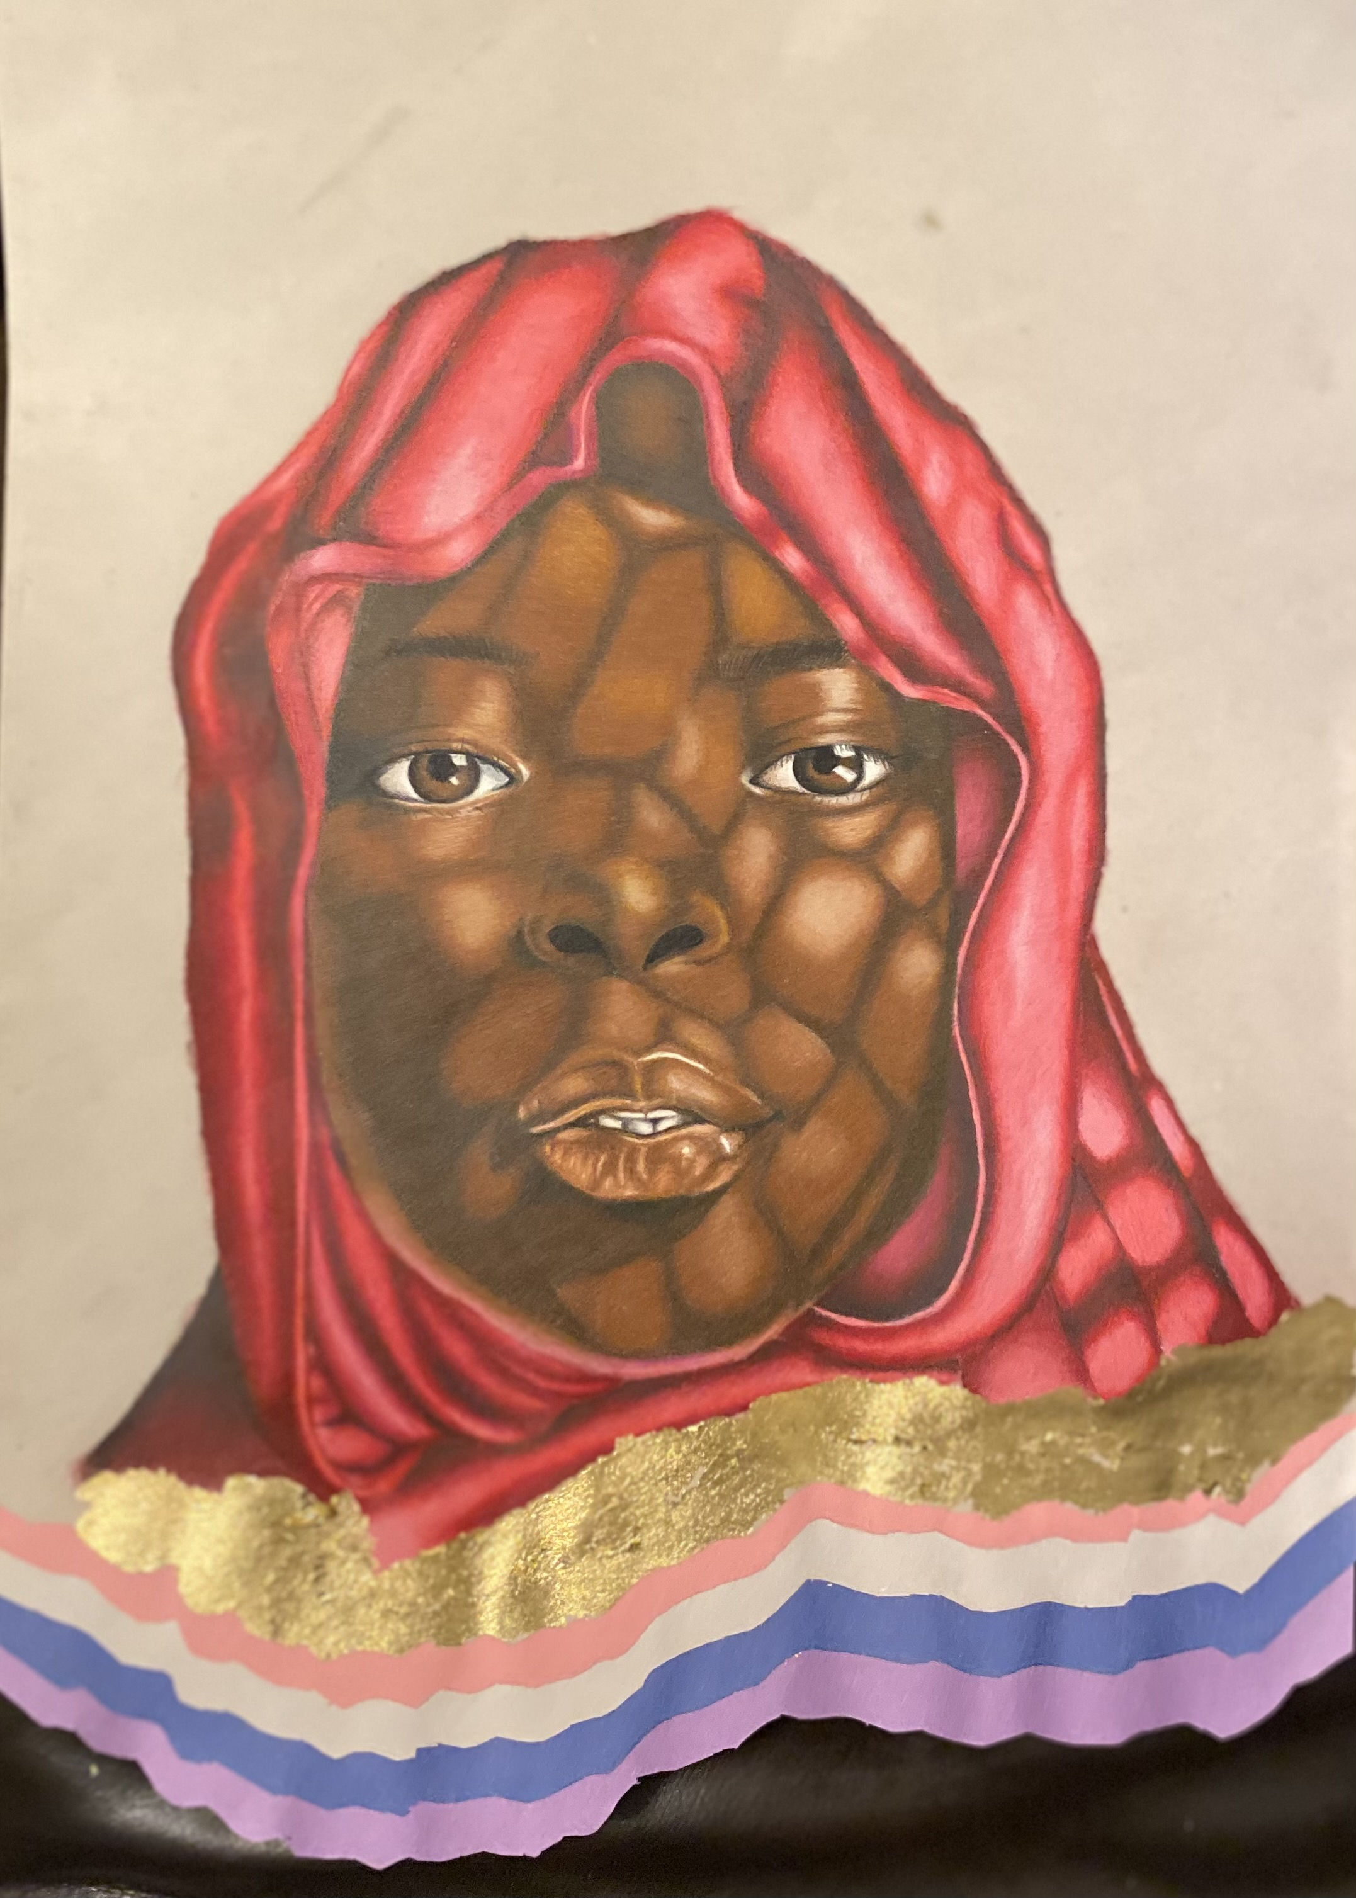
Congratulations! ​
Congratulations to 11 of our principals for receiving City Council Funding for the Arts (each school received over $16,000):
PS 50
PS 55
PS 82
PS 86
PS 99
PS 117
PS 174
PS 175
PS 220
PS 349
PS 354
Art by various NYCPS artists

Slide 13
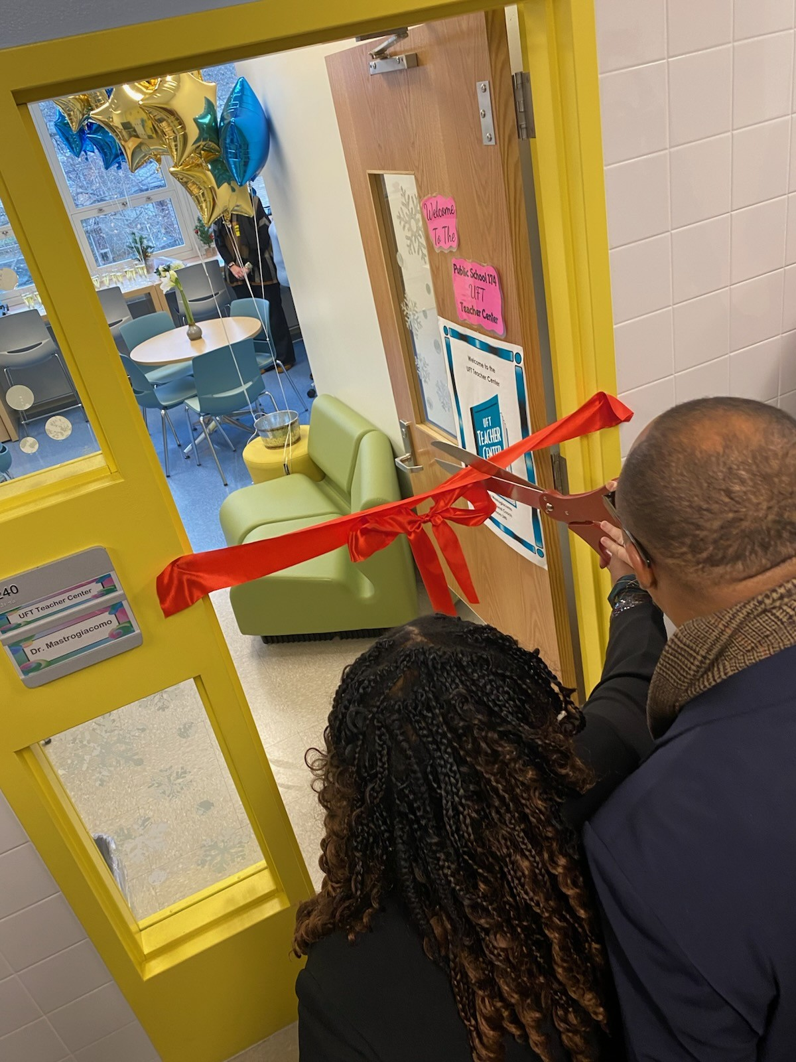
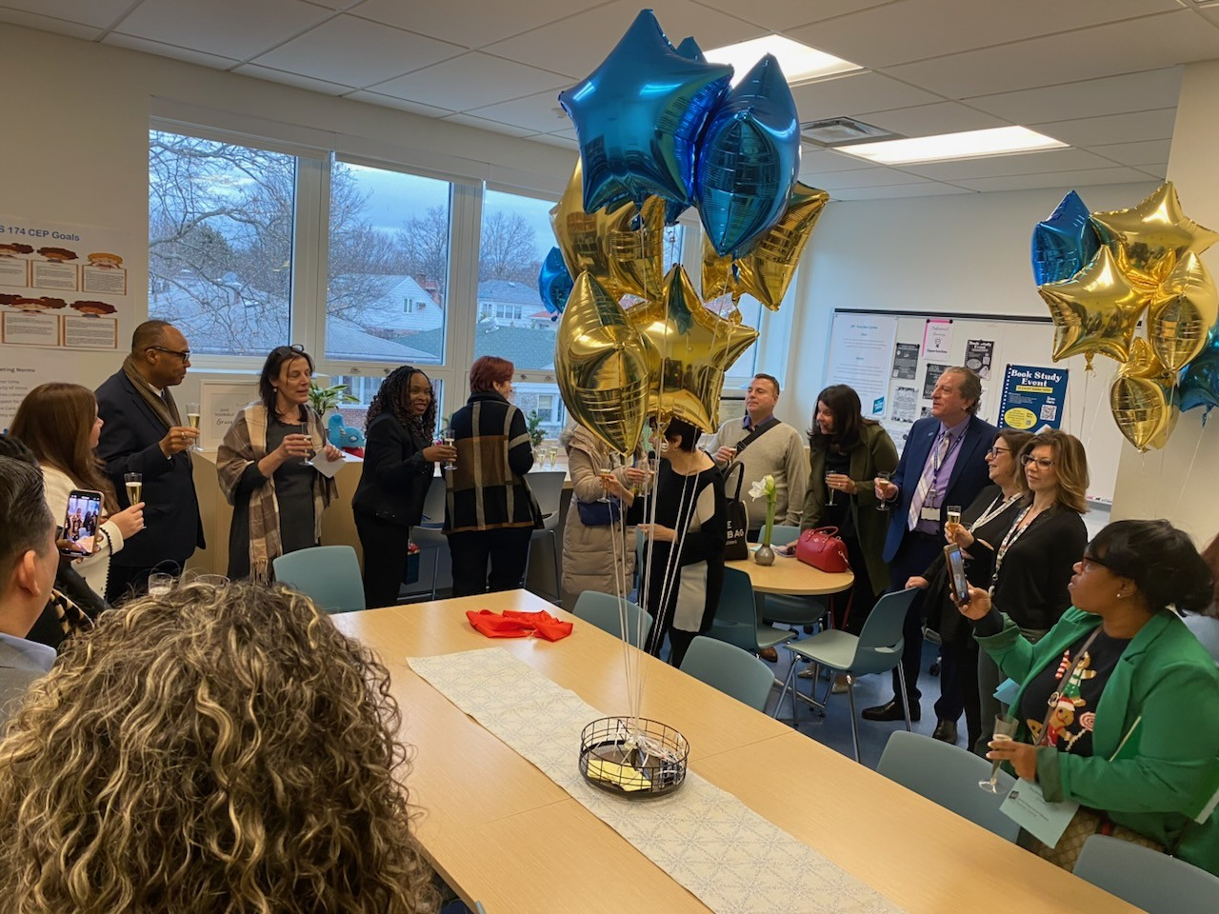
D28 UFT Teacher Center at PS 174
PS 174 had a ribbon cutting ceremony to launch its UFT Teacher Center on December 20th. We look forward to continuing to build our partnership with our schools and the UFT!

Slide 14
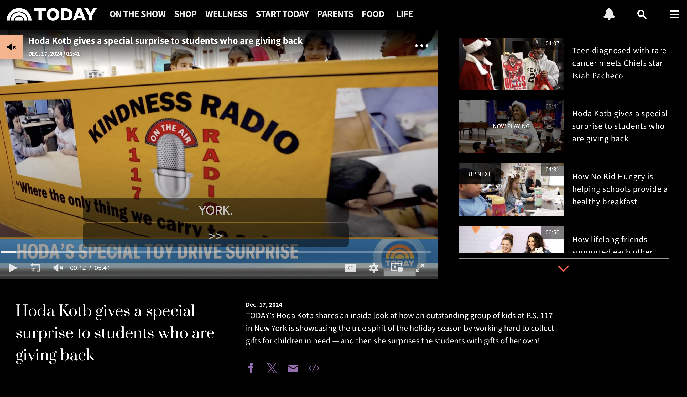
D-28 Featured on NBC’s Today Show
PS 117Q The Briarwood School – Principal Van Gunten
Congratulations to PS 117 for being showcased by NBC's Today show! Your various kindness initiatives and the incredible work of your student leadership groups are truly inspiring. Keep up the amazing work!
Please select below to PLAY!
The Briarwood School Gives BACK :)

